Slide 1


Data Structures
ETCCDS202
Dr. Aarti
Faculty
School of Engineering & Technology
K.R. Mangalam University
Unit 2 : Linear Data Structures

Slide 2

Unit-2 Linear Data Structures
SESSION 11 Arrays – 1D & 2D
SESSION 12 Static & Dynamic Arrays
SESSION 13 Linked Lists Types
SESSION 14 Linked List Operations
SESSION 15 Stack ADT & Operations
SESSION 16 Stack Applications
SESSION 17 Queue ADT
SESSION 18 Queue Applications
SESSION 19 BFS using Queue
SESSION 20 Revision (Unit–2)
Notes:
New Courses replaced with New Programmes

Slide 3
Queue Applications
Session 18
Introduction to Queue Applications
Why FIFO is important for real systems
Applications of Queue – Overview
Circular Queue – Need & Concept
Circular Queue Operations & Algorithms (Array)
Advantages & Disadvantages of Circular Queue
Applications of Circular Queue
Priority Queue – Concept & Operations
Priority Queue Implementations (Array/Heap/Linked List)
Key Takeaways
References
Notes:
New Courses replaced with New Programmes

Slide 4
Recapitulation (Queue ADT)
Queue follows the FIFO principle.
Insertion is done using enqueue at the rear.
Deletion is done using dequeue from the front.
Implementations: array-based and linked-list-based.
Overflow occurs when the queue is full; underflow occurs when it is empty.
Notes:
New Courses replaced with New Programmes

Slide 5
Quick Quiz
Queue follows the __________ principle.
The pointer that indicates the first element is called __________.
The operation used to insert an element is __________.
Queue underflow occurs when __________.
Which operation removes an element from a queue?
Name one application of queue.
Which implementation allows dynamic size?
Notes:
New Courses replaced with New Programmes

Slide 6
Learning Objectives
After this lecture, students will be able to:
Explain how queues are used in operating systems, networking, and algorithms
Describe the role of FIFO in CPU scheduling, buffering, and BFS
Differentiate between linear queue, circular queue, deque, and priority queue
Apply queue operations to solve real-world problems
Choose an appropriate queue type for a given application
Notes:
New Courses replaced with New Programmes

Slide 7
Applications of Queue
CPU Scheduling
Printer Spooling
Process Synchronization
Breadth-First Search (BFS)
Network Packet Handling
Customer Service Systems
Traffic Management System
Notes:
New Courses replaced with New Programmes

Slide 8
Check Your Understanding
Queue follows the __________ principle.
In CPU scheduling, processes wait in the __________ queue.
BFS explores nodes __________ by __________.
In printer spooling, print jobs are processed in __________ order.
Why is queue suitable for customer service systems?
Name one networking application of queue.
Notes:
New Courses replaced with New Programmes

Slide 9

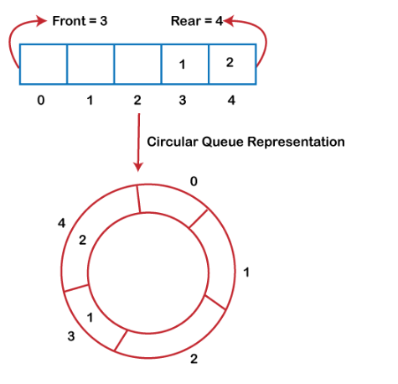
Why was the circular queue?
If the rear reaches to the end position of the Queue then there might be possibility that some vacant spaces are left in the beginning which cannot be utilized.
To overcome such limitations, the concept of the circular queue was introduced.
https://www.javatpoint.com/data-structure-queue
Notes:
New Courses replaced with New Programmes

Slide 10
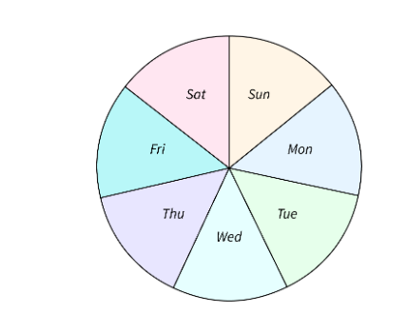
Circular Queue?
It is also based on the FIFO (First In First Out) principle except that the last position is connected to the first position in a circular queue that forms a circle.
It is also known as a Ring Buffer.
https://www.scaler.com/topics/data-structures/queue-in-data-structure/
Notes:
New Courses replaced with New Programmes

Slide 11
Operations
Front: It is used to get the front element from the Queue.
Rear: It is used to get the rear element from the Queue.
EnQueue(value): This function is used to insert the new value in the Queue. The new element is always inserted from the rear end.
DeQueue(): This function deletes an element from the Queue. The deletion in a Queue always takes place from the front end.
https://www.youtube.com/watch?app=desktop&v=gYxdHbbjn_8
Notes:
New Courses replaced with New Programmes

Slide 12
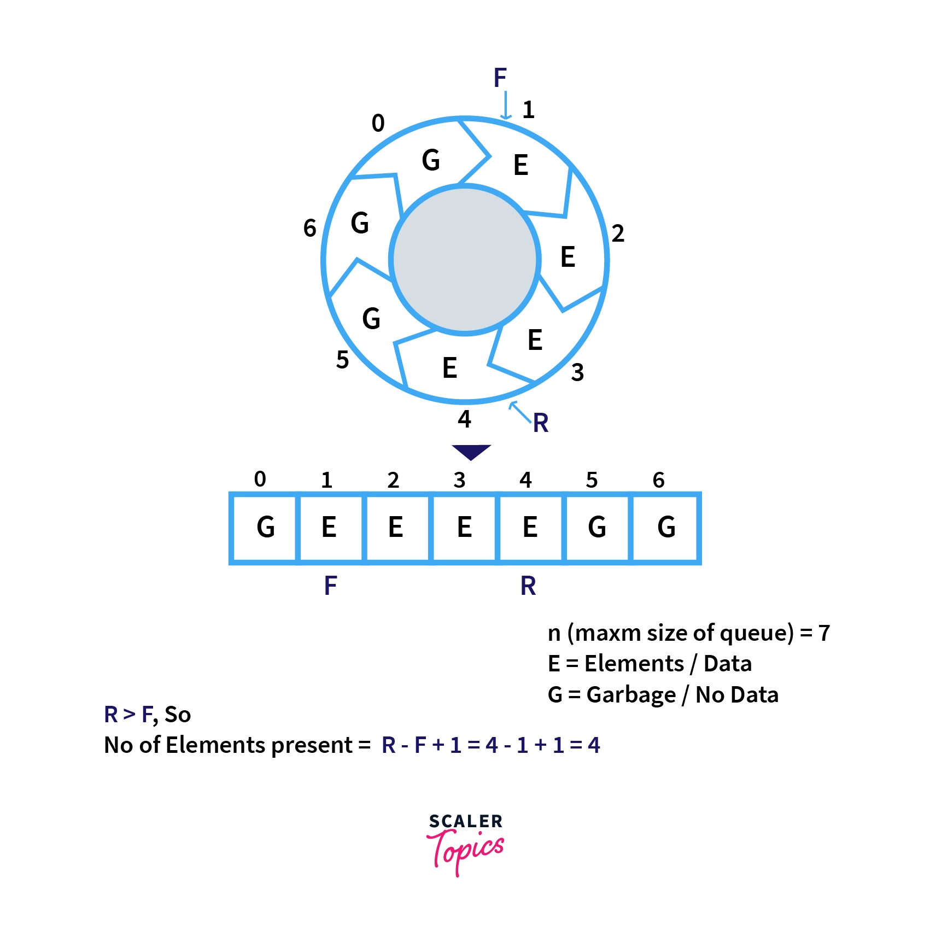
Representation using Array
https://www.youtube.com/watch?app=desktop&v=gYxdHbbjn_8
Notes:
New Courses replaced with New Programmes

Slide 13
Implement Circular Queue using Array:
Insertion
Step 1 : If FRONT = (REAR + 1) % MAXSIZE : then
Write : “Queue Overflow” and return.
[End of If structure]
Step 2 : Read NUM to be inserted in Circular Queue.
Step 3 : If FRONT= -1 : then
Set FRONT = REAR =0.
Else
Set REAR=(REAR + 1) % MAXSIZE.
[End of If Else structure]
Step 4 : Set CQUEUE[REAR]=NUM;
Step 5 : Exit
Notes:
New Courses replaced with New Programmes

Slide 14
Implement Circular Queue using Array:
Deletion
Step 1 : If FRONT = - 1 : then
Write : “Queue Underflow” and return.
[End of If Structure]
Step 2 : Set NUM = CQUEUE[FRONT].
Step 3 : Write ‘Deleted element from circular queue is : ",NUM.
Step 4 : If FRONT = REAR : then
Set FRONT = REAR = -1;
Else
Set FRONT = (FRONT + 1) % MAXSIZE.
Step 5 : Exit
Notes:
New Courses replaced with New Programmes

Slide 15
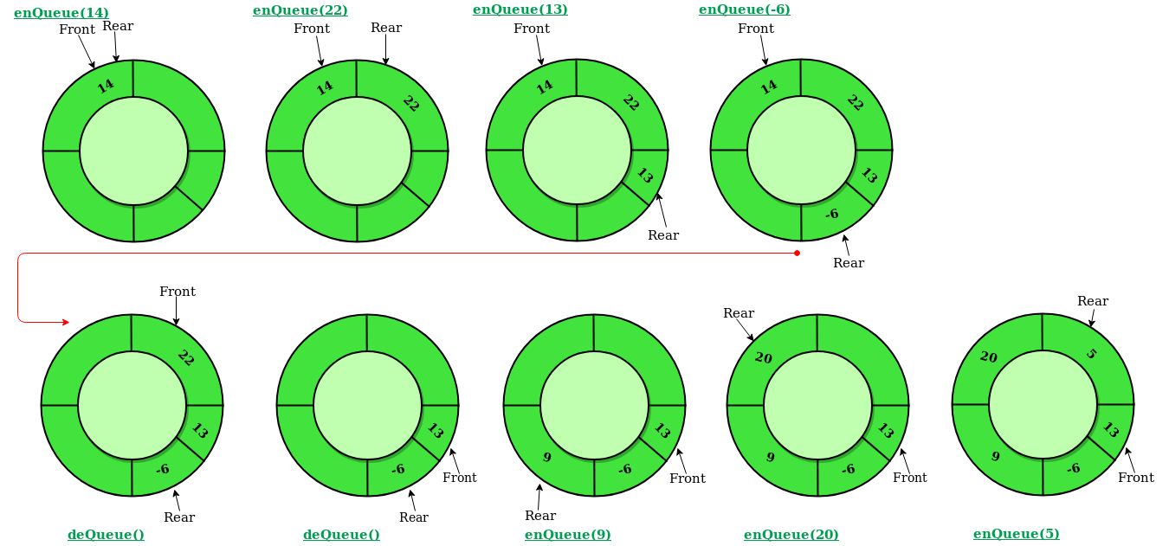
Illustration of Circular Queue Operations:
https://www.geeksforgeeks.org/introduction-to-circular-queue/
Notes:
New Courses replaced with New Programmes

Slide 16
Advantages of Circular Queue Operations
Efficient space utilization: Circular queues efficiently use the available memory space.
No shifting of elements: Elements are continuously added and removed without the need to shift remaining elements.
Simple implementation: It's relatively straightforward to implement a circular queue using an array.
Notes:
New Courses replaced with New Programmes

Slide 17
Disadvantage of Circular Queue Operations
Fixed size: Circular queues have a fixed capacity determined by the size of the underlying array.
Potential for confusion: The circular nature of the queue can sometimes lead to confusion in understanding its behavior, especially with wraparound scenarios.
Notes:
New Courses replaced with New Programmes

Slide 18
Applications of Circular Queue Operations
Applications:
Operating systems for managing task scheduling.
Networking for managing packets in routers and switches.
Memory management in embedded systems.
Simulation of resource allocation scenarios.
Notes:
New Courses replaced with New Programmes

Slide 19
Code for insertion &deletion Operation Of Queue (Python)
queue = [0] * 5
front = -1
rear = -1
size = 5
def enqueue(value):
global front, rear
if rear == size - 1:
print("Queue Overflow")
else:
if front == -1:
front = 0
rear += 1
queue[rear] = value
print(value, "inserted")
def dequeue():
global front, rear
if front == -1 or front > rear:
print("Queue Underflow")
else:
print("Deleted element:", queue[front])
front += 1
# Example usage
enqueue(10)
enqueue(20)
enqueue(30)
dequeue()
dequeue()
Notes:
New Courses replaced with New Programmes

Slide 20
Output
Elements in Circular Queue are:
14 22 6
Deleted value = 14
Deleted value = 22
Elements in Circular Queue are: 6
Elements in Circular Queue are: 6 9 20;
Notes:
New Courses replaced with New Programmes

Slide 21
Test Yourself
A standard circular Queue 'q' implemented whose size is 11 from 0 to 10. The front & rear pointers start to point at q[2]. The ninth element be added at which position?
q[0]
q[1]
q[9]
q[10]
Solution: a. q[0]
Notes:
New Courses replaced with New Programmes

Slide 22
Test Yourself
Choose the incorrect statement?
If Queue is implemented through the linked list, keeping track of a front pointer will change only rear pointer "s" during insertion into non-empty Queue.
The Queue can be used to implement the least recently used page fault algorithm and Quicksort algorithm.
The Queue can be used to implement the Quicksort algorithm but not least recently used (LRU) page fault algorithm.
Both (A) and (C)
Solution: c. The Queue can be used to implement the Quicksort algorithm but not least recently used (LRU) page fault algorithm.
Notes:
New Courses replaced with New Programmes

Slide 23
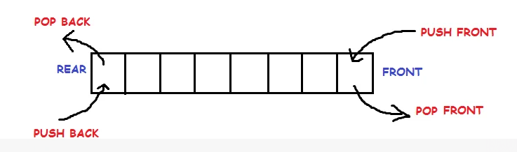
Doubly Ended Queue
Notes:
New Courses replaced with New Programmes

Slide 24
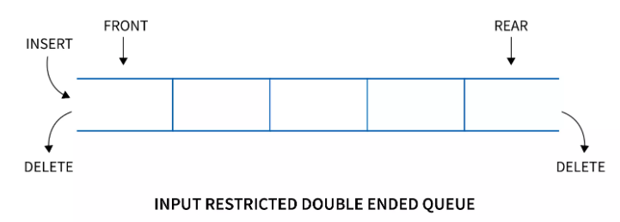
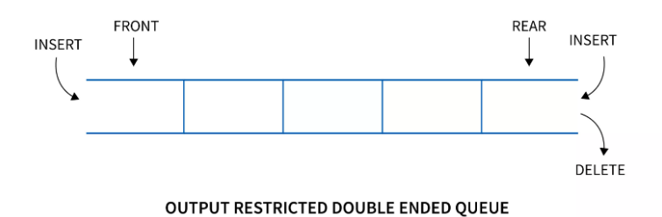
Doubly Ended Queue
Types
Input restricted queue
Output restricted queue
Notes:
New Courses replaced with New Programmes

Slide 25
Operations performed on Deque
There are the following operations that can be applied on a deque -
Insertion at front
Insertion at rear
Deletion at front
Deletion at rear
Get the front item from the deque
Get the rear item from the deque
Check whether the deque is full or not
Checks whether the deque is empty or not
Notes:
New Courses replaced with New Programmes

Slide 26

Priority Queues
https://www.simplilearn.com/tutorials/data-structure-tutorial/priority-queue-in-data-structure
Notes:
New Courses replaced with New Programmes

Slide 27
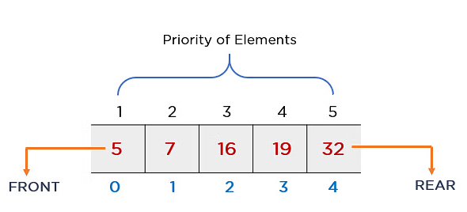
Priority Queues
The priority of elements determines the order of removal in a queue, i.e., the element with higher priority will leave the queue first, whereas the element with the lowest priority at last
https://www.simplilearn.com/tutorials/data-structure-tutorial/priority-queue-in-data-structure
Notes:
New Courses replaced with New Programmes

Slide 28
Priority Queues
Priority Order
Ascending Order
Descending Order
Notes:
New Courses replaced with New Programmes

Slide 29
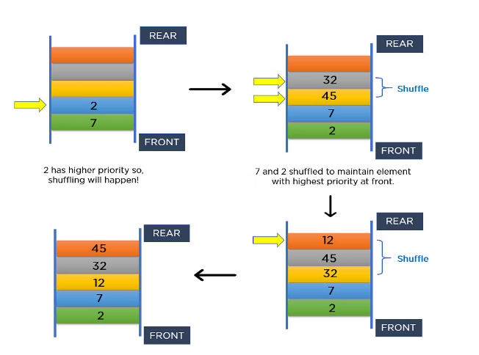
Priority Queues
https://www.simplilearn.com/tutorials/data-structure-tutorial/priority-queue-in-data-structure
Notes:
New Courses replaced with New Programmes

Slide 30
Priority Queues
https://www.simplilearn.com/tutorials/data-structure-tutorial/priority-queue-in-data-structure
Notes:
New Courses replaced with New Programmes

Slide 31
Priority Queue Applications
Operating systems
Time-activated events
Managing responsibilities
Sorting
Djikstra’s Algorithm
Prim’s Algorithm
Notes:
New Courses replaced with New Programmes

Slide 32
Implementation of Priority Queue
Using Linked List
Using Binary Heap
Using Array
Binary Search Tree
Notes:
New Courses replaced with New Programmes

Slide 33
Operation on Priority Queue
Insertion:
Insertion operation is used to insert a new element into the queue. Whenever a new element is inserted,
The new element is moved to an empty slot top to bottom and left to right.
If the inserted element is not in the correct position. It will be compared with the parent element.
And if the element is not in the correct order, then elements are swapped until the inserted element gets to the correct position.
Notes:
New Courses replaced with New Programmes

Slide 34
Operation on Priority Queue
Algorithm:
if (the queue is empty)
Create a node
else //when node is already present
Insert the new node at the end of the queue (last node from left to right) heapify the array
Notes:
New Courses replaced with New Programmes

Slide 35
Operation on Priority Queue
Deletion:
Deletion operation is used to remove any element from the queue, For deleting any element,
Choose the element which needs to be deleted.
Swap it with the last element.
Remove the last element
Heapify the array.
Notes:
New Courses replaced with New Programmes

Slide 36
Operation on Priority Queue
Deletion:
Algorithm:
if (node== leaf node)
delete node
else //when node is not leaf node
Swap node with leaf node
Delete the leaf node
heapify the array
Notes:
New Courses replaced with New Programmes

Slide 37
Implementation of Priority Queue Using Array:
The basic implementation using array is:
struct node
{
int node:
int priority:
}
Notes:
New Courses replaced with New Programmes

Slide 38
Implementation of Priority Queue Using Array:
Operations in array:
enqueue(): It is used to insert new element into the priority queue.
dequeue(): It removes an element with the highest priority from the priority queue.
peek(): It is used to determine the highest priority element in the queue without removing it.
Notes:
New Courses replaced with New Programmes

Slide 39
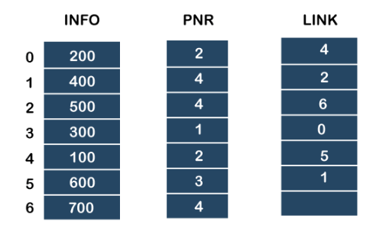
Implementation of Priority Queue
https://www.javatpoint.com/ds-priority-queue
Notes:
New Courses replaced with New Programmes

Slide 40
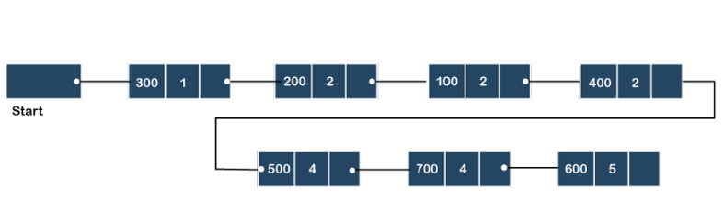
Implementation of Priority Queue
Using link list
https://www.javatpoint.com/ds-priority-queue
Notes:
New Courses replaced with New Programmes

Slide 41
Algorithm for Insertion at rear end
Step-1: [Check for overflow]
if(rear==MAX)
Print("Queue is Overflow”);
return;
Step-2: [Insert Element]
else
rear=rear+1;
q[rear]=no;
[Set rear and front pointer]
if rear=0
rear=1;
if front=0
front=1;
Step-3: return
Notes:
New Courses replaced with New Programmes

Slide 42
Algorithm for Insertion at front end
Step-1 : [Check for the front position]
if(front<=1)
Print("Cannot add item at the front”);
return;
Step-2 : [Insert at front]
else
front=front-1;
q[front]=no;
Step-3 : Return
Notes:
New Courses replaced with New Programmes

Slide 43
Algorithm for Deletion from front end
Step-1 [ Check for front pointer]
if front=0
print(" Queue is Underflow”);
return;
Step-2 [Perform deletion]
else no=q[front];
print(“Deleted element is”,no);
[Set front and rear pointer]
if front=rear
front=0;
rear=0;
else front=front+1;
Step-3 : Return
Notes:
New Courses replaced with New Programmes

Slide 44
Algorithm for Deletion from rear end
Step-1 : [Check for the rear pointer]
if rear=0
print(“Cannot delete value at rear end”);
return;
Step-2: [ perform deletion]
else no=q[rear];
[Check for the front and rear pointer]
if front= rear
front=0;
rear=0;
else rear=rear-1;
print(“Deleted element is”,no);
Step-3 : Return
Notes:
New Courses replaced with New Programmes

Slide 45
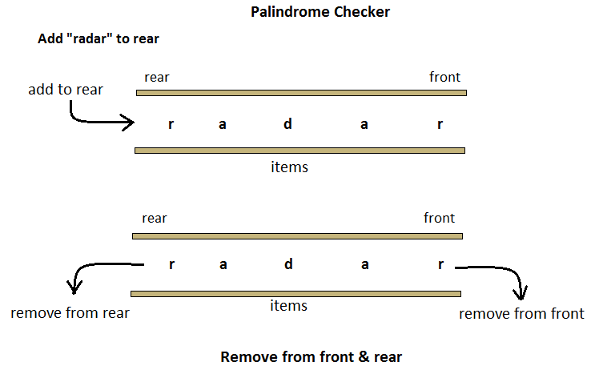
Applications
Notes:
New Courses replaced with New Programmes

Slide 46
Check Your Understanding
Why was the circular queue introduced?
What condition indicates overflow in a circular queue?
Which queue removes elements based on priority?
What is the time complexity of enqueue and dequeue in a circular queue?
Notes:
New Courses replaced with New Programmes

Slide 47
Key Takeaways
Queue is fundamental for fair and ordered processing (FIFO).
It is widely used in CPU scheduling, printer spooling, BFS, networking, and traffic systems.
Circular queues improve space utilization over linear array queues.
Priority queues process elements based on priority, not arrival time.
Choosing the right queue type improves performance and resource utilization.
Notes:
New Courses replaced with New Programmes

Slide 48
References
Textbooks
Cormen, T. H., Leiserson, C. E., Rivest, R. L., & Stein, C., Introduction to Algorithms, MIT Press.
Lipschutz, S., Schaum’s Outline of Data Structures with C++, McGraw-Hill Education.
Reference Books
Weiss, M. A., Data Structures and Algorithm Analysis in C++, 5th Edition, Pearson Education.
Skiena, S. S., The Algorithm Design Manual, 3rd Edition, Springer.
Online Resources
GeeksforGeeks – Queue Applications https://www.geeksforgeeks.org/queue-data-structure/
JavaTpoint – Queue & Circular Queue https://www.javatpoint.com/data-structure-queue
Scaler – Circular Queue https://www.scaler.com/topics/data-structures/queue-in-data-structure/
Simplilearn – Priority Queue https://www.simplilearn.com/tutorials/data-structure-tutorial/priority-queue-in-data-structure
Programiz – Queue in Python https://www.programiz.com/dsa/queue
Notes:
New Courses replaced with New Programmes

Slide 49
THANK YOU

